Slide 1
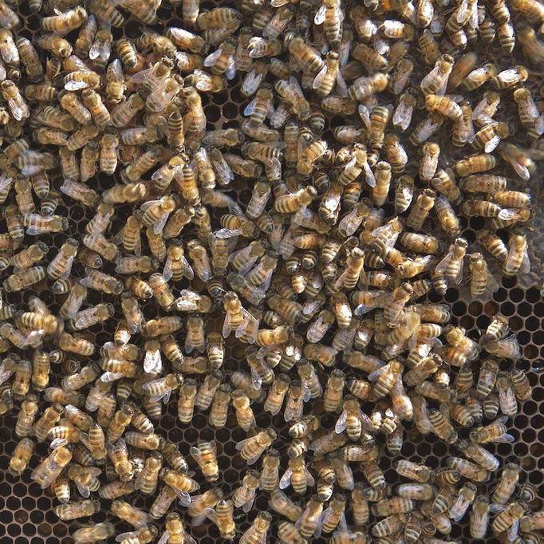
C♯ ASP.NET Core Web API part deux
Rasmus Lystrøm
Associate Professor
ITU
This Photo by Unknown Author is licensed under CC BY-SA-NC

Slide 2
Remember: Project meeting with TAs this afternoon
(Mandatory)

Slide 3

Agenda
Completing the CharactersController
Design Patterns in Practice
gRPC
GraphQL
Docker and Docker Compose
Integration Testing ASP.NET Core
(Gilded Rose Recap)
This Photo by Unknown Author is licensed under CC BY-NC-ND

Slide 4
Completing the CharactersController
Demo

Slide 5

Design Patterns in Practice

Slide 6
IoC Container
Tool to facilitate dependency injection.
Using a factory to either manually or automatically create types at runtime.
Various implementations:
Microsoft.Extensions.DependencyInjection
Ninject
Unity
AutoFac
StructureMap

Slide 7
IoC Container II
Lifetime:
Transient
Scoped
Singleton
Lifetime:
Transient (every time)
Scoped (once per request)
Singleton (once)

Slide 8
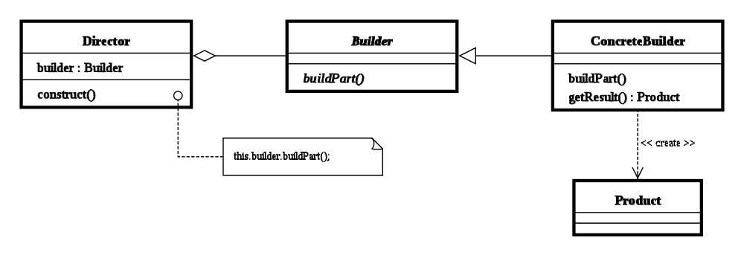
Builder
Separate the construction of a complex object from its representation
serviceCollection.AddScoped<,>();
serviceCollection.BuildServiceProvider();

Slide 9
Singleton
Only ever one single instance of a given type.
Considered an anti-pattern by many, it:
is overused
introduces unnecessary restrictions in situations where a sole instance of a class is not actually required
introduces global state into an application

Slide 10

Singleton II
Use carefully
Implement using an interface
Use an IoC container

Slide 11
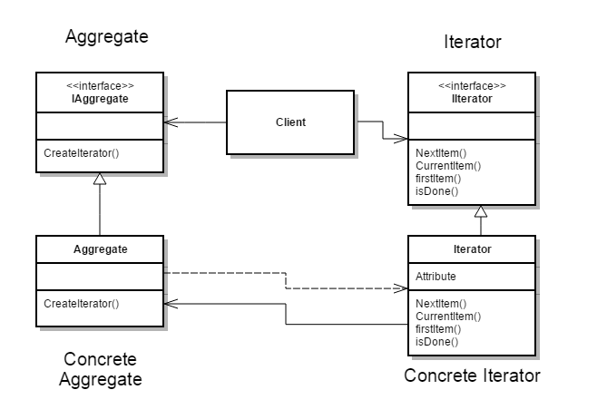
Iterator
Provide a way to access the elements of an aggregate object (collection) sequentially without exposing the underlying representation
IEnumerable
IEnumerable<T>
IEnumerator
IEnumerator<T>
foreach...

Slide 12
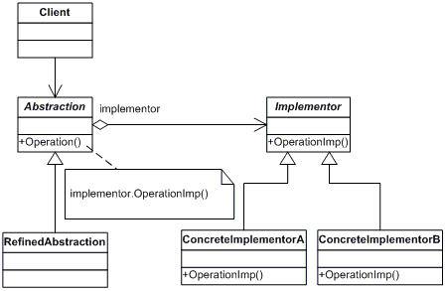
Bridge
Decouple an abstraction from its implementation so that the two can vary independently.

Slide 13
Docker & Docker Compose
Demo

Slide 14
gRPC

Slide 15
gRPC Remote Procedure Calls
gRPC is a modern, open source, high-performance remote procedure call (RPC) framework that can run anywhere. gRPC enables client and server applications to communicate transparently, and simplifies the building of connected systems.
$ dotnet new grpc
Source: https://github.com/grpc/grpc

Slide 16
GraphQL

Slide 17
GraphQL
GraphQL is a query language for APIs and a runtime for fulfilling those queries with your existing data. GraphQL provides a complete and understandable description of the data in your API, gives clients the power to ask for exactly what they need and nothing more, makes it easier to evolve APIs over time, and enables powerful developer tools.
Source: https://graphql.org/

